Slide 1
Java servlet
Java Servlet technology provides dynamic, user-oriented content in web applications using a request-response programming model.

Slide 2
What is Java servlet
A servlet is a Java programming language class used to extend the capabilities of servers that host applications accessed by means of a request-response programming model. Although servlets can respond to any type of request, they are commonly used to extend the application hosted by web servers. For such applications, Java Servlet technology defines HTTP-specific servlet classes

Slide 3
Servlet lifecycle
The lifecycle of a servlet is controlled by the container in which the servlet has been deployed. When a request is mapped to a servlet, the container performs the following steps.
1. If an instance of servlet does not exist, the web container:
A. Loads the servlet class
B. Creates an instance of the servlet class
C. Initializes the servlet instance by calling the init method
2. The container invokes the service method, passing request and response objects.

Slide 4
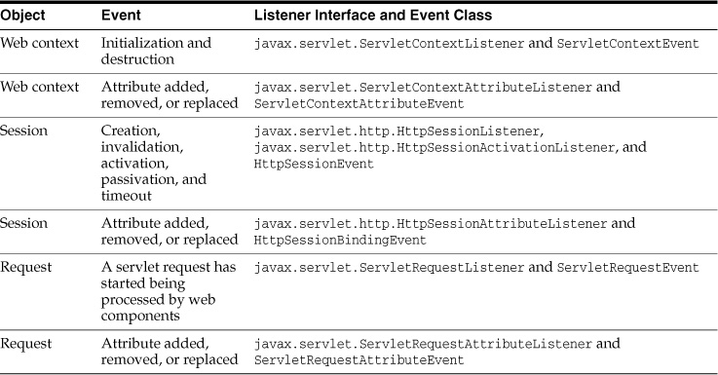
Defining the listener class
You define a listener class as an implementation of a listener interface
Notes:
Use the @Weblistener annotation to define a listener to get events for various operations on the particular web application context.

Slide 5
Sharing information
Web components, like most objects, usually work with other object to accomplish their tasks. Web components can do so by doing the following.
Using private helper objects(EX: JavaBeans components)
Sharing objects that are attributes of a public scope
Using a database
Invoking other web resources.
Notes:
Scope objects: page, request, session, web context

Slide 6
Controlling concurrent access to shared resources
In a multithreaded server, shared resources can be accessed concurrently. In addition to scope object attributes, share resources include in-memory data, such as instance or class variables, and external objects, such as files, database connection, and network connections.
Concurrent access can arise in several situations.
Multiple web components accessing objects stored in the web context.
Multiple web components accessing objects stored in a session
Multiple threads within a web component accessing instance variables.
Notes:
A web container will typically create a thread to handle each request. To ensure that a servlet instance handles only one request at a time, a servlet can implement the SingleThreadModel interface

Slide 7
Creating and initializing a servlet
The web container initializes a servlet after loading and instantiating the servlet class and before delivering requests
from clients. To customize this process to allow the servlet to read persistent configuration data, initialize resources,
and perform any other one-time activities, you can either override the init method of the Servlet interface or specify
the initParams attribute of the @WebServlet annotation. The initParamsattribute contains a @WebInitParam annotation.
If it cannot complete its initialization process, a servlet throws an UnavailableException. Use an initialization parameter
to provide data needed by a particular servlet. By contrast, a context parameter provides data that is available to
all components of a web application.
Notes:
Use @Webservlet annotation to define a servlet component in a web application.
This annotation is specified on a class an contains metadata about the servlet being
Declared. The annotated servlet must specify at least one URL pattern

Slide 8
Writing service methods
The service provided by a servlet is implemented in the service method of a GenericServlet, in the do Method (can take the value Get, Delete, Options, Post, Put, or Trace) of HttpServlet object
The general pattern for a service method is to extract information from the request, access external resources, and then populate the response, based on that information. For HTTP servlets, the correct procedure for populating the response is to do the following:
Retrieve an output stream from the response
Fill in response headers.
Write any body content to the output stream
Notes:
The term service method is used for any method in a servlet class that provides a service to a client.
Response headers must always be set before the response has been committed. The web container will ignore any attempt to set or add headers after the response has been committed. The next two sections describe how to get information from requests and generate responses.

Slide 9
Getting information from requests
A request contains data passed between a client and the servlet. All request implement the ServletRequest interface. This interface defines methods for accessing the following information.
Parameters, which are typically used to convey information between client and servlets.
Object-valued attributes, which are typically used to pass information between web container and a servlet or between collaborating servlets
Information about the protocol used to communicate the request and about the client and server involved in the request
Information relevant to localization
Notes:
Context path: A concatenation of a forward slash(/) with the context root of the servlet’s web application
Servlet path: The path section that corresponds to the component alias that activated this request.
This path start with a forward slash(/)
Path info: The part of the request path that is not part of the context path or the servlet path

Slide 10
Getting information from requests (cont)
Query strings are composed of a set of parameters and values. Individual parameters are retrieved from a request by using the getParameter method. There are two ways to generate query strings.
A query string can explicitly appear in a web page.
A query string is appended to a URL when a form with a GET HTTP method is submited

Slide 11
Constructing reponses
All responses implement the ServletResponse interface. This interface defines methods that allow you to do the following:
Retrieve an output stream to used to send data to the client. To send character data used PrintWriter returned by reponse’s getWriter method. To send binary data in a MIME body response, use ServletOutputStream returned by getOutputStream.
Indicate the content type being returned by the response with setContentType(String) method. This method must be called before the response is committed. A registry of content type name is kept by the IANA
Indicate whether to buffer output with the setBufferSize(int) method. By default, any content written to the output stream is immediately send to the client. Buffering allows content to be written before anything is sent back to the client, thus providing the servlet with more time to set appropriate status codes and headers or forward to another web resource. The method must be called before any content is written or before the response is committed
Set localization information, such as locale and character encoding.
Status codes, which are used to indicate the reason a request is not satisfied or that a request has been redirected.
Cookies, which are used to store application-specific information at the client. Sometimes, cookies are used to maintain an identifier for tracking a user’s sessi

Slide 12
Filtering requests and responses
A filter is an object that can transform the header and content (or both) of a request or response. Filters differ from web components in that filters usually do not themselves create a response. Instead, a filter provides functionality that can be “attached” to any kind of web resource. Consequently, a filter should not have any dependencies on a web resource for which it is acting as a filter; this way, it can be composed with more than one type of web resource.

Slide 13
The main tasks that a filter can perform are as follows:
Query the request and act accordingly
Block the request-and-response pair from passing any further
Modify the request header and data. You do this by providing a customized version of the request
Modify the response headers and data. You do this by providing a version of the response
Interact with external resources
You can configure a web resource to be filtered by a chain of zero, one, or more filters in a specific order. This chain is specified when the web application containing the component is deployed and is instantiated when a web container loads the component
Notes:
Applications of filters include authentication, logging, image conversion, data compression, encryption, tokenizing streams, XML transformations, and so on.

Slide 14
Programming filters
The filtering API is defined by the Filter, FilterChain, FilterConfig interface in javax.servlet
@WebFilter annotation to define a filter in a web application. This annotation is specified on a class and contains metadata about the filter being declared. The annotated filter must specify at least one URL pattern. This is done by using the urlPattern or value attribute on the pattern.
The most important method in the Filter interface is doFilter, which is passed request, response, and filter chain objects. This method can perform the following actions:
Examine the request headers.
Customize the request object if the filter wishes modify request headers or data
Customize the response object if the filter wishes to modify response headers or data

Slide 15
Invoke the next entity in the filter chain. If the current filter is the last filter in the chain that ends with the target web component or static resource, the next entity is the resource at the end of the chain; otherwise, it is the next filter that was configured in the WAR. The filter invokes the next entity by calling the doFilter method on the chain object, passing in the request and response it was called with or the wrapped versions it may have created. Alternatively, the filter can choose to block the request by not making the call to invoke the next entity. In the latter case, the filter is responsible for filling out the response.
Examine response headers after invoking the next filter in the chain.
Throw an exception to indicate an error in processing.
Notes:
In addition to doFilter, you must implement the init and destroy methods. The init method is called by the container when the filter is instantiated. If you wish to pass initialization parameters to the filter, you retrieve them from the FilterConfig object passed to init.

Slide 16
Programming Customized Requests and Responses
There are many ways for a filter to modify a request or a response
A filter that modifies a response must usually capture the response before it is returned to the client. To do this, you pass a stand-in stream to the servlet that generates the response. The stand-in stream prevent the servlet from closing the original response stream when it completes and allows the filter to modify the servlet’s response.
To pass this stand-in stream to the servlet, the filter creates a response wrapper is passed to the doFilter method of the filter chain. Wrapper methods default to calling through to the wrapped request or response object.
To override request methods, you wrap the request in an object that extends either ServletRequestWrapper or HttpServletRequestWrapper. To override response methods, you wrap the response in an object that extend either ServletResponseWrapper or HttpServletResponseWrapper

Slide 17
Invoking other web resources
Web components can invoke other web resources both indirectly and directly. A web component indirectly invokes another web resource by embedding a URL that points to another web component in content returned to a client. While it is executing, a web component directly invokes another resource by either including the content of another resource or forwarding a request to another resource
To invoke a resource available on the server that is running a web component, you must first obtain a RequestDispatcher object by using getRequestDispatcher(“URL”) method.
The method takes the path to the requested resource as an argument. A request can take a relative path (that is, one that does not begin with a /), but the web context requires an absolute path. If the resource is not available or if the server has not implemented a RequestDispathcher object for that type of resource, getRequestDispathcher will return null. You servlet should be prepared to deal with his condition.

Slide 18
Including Other Resources in the Response
To include another resource, invoke the include method of a RequestDispathcher object
Include(request, response)
If the resource is static, the include method enables programmatic server-side includes. If the resource is a web component, the effect of the method is to send the request to the included web component, execute the web component, and then includes.

Slide 19
Transferring Control to Another Web Component
In some application, you might want to have one web component do processing of a request and have another component generate the response.
To transfer control to another web component, you invoke the forward method of Requestdispatcher. When request forwarded, the request URL is set to path of the forwarded page.
The original URI and its constituent parts are saved as the following request attributes:
Javax.servlet.forward.request_uri
Javax.servlet.forward.context_path
Javax.servlet.forward.servlet_path
Javax.servlet.forward.path_info
Javax.servlet.forward.query_string
Notes:
The forward method should be used to give another resource responsibility for replying to the user. If you have already accessed a ServletOutputStream or PrintWriter object within the servlet, you cannot use this method; doing so throws an IllegalStateException.

Slide 20
Specifying Filter mappings
A web container filter mapping to decide how to apply filters to web resources. A filter matches a filter to a web component by name or to web resources by URL pattern. The filters are invoked in the order in which filter mappings appear in the filter mapping list of a WAR. You specify a filter mapping list for a WAR in its deployment descriptor XML.
If you want to log every request to a web application, you map the hit counter filter to the URL pattern /*.

Slide 21
Accessing the web context
The context in which web components execute is an object that implement the ServletContext interface. You retrieve the web context by using the getServletContext method. The web context provides methods for accessing
Initialization parameters
Resources associated with the web context
Object-valued attributes
Logging capabilities

Slide 22
Maintaining client state
Many applications require that a series of requests from a client be associated with one another. For example, a web application can save the state of a user’s shopping cart across requests. Web-based applications are responsible for maintaining such state, called a session, because HTTP is stateless. To support applications that need to maintain state, Java servlet technology provides an API for managing session and allows several mechanisms for implementing sessions.
Accessing a Session: Session are represented by an HttpSession object. You access a session by calling the getSession method of a request object. “This method returns the current session associated with this request; or, if the request does not have a session, this method creates one.
Associating objects with a session: You can associate object-valued attributes with a session by name. Such attributes are accessible by any web component that belongs to the same web context and is handling a request that is part of the same session
Notes:
When the object is added to or removed from a session. To receive this notification, your object must implement the javax.servlet.http.HttpSessionBindingListener interface.
passivated or activated. A session will be passivated or activated when it is moved between virtual machines or saved to and restored from persistent storage. To receive this notification, your object must implement the javax.servlet.http.HttpSessionActivationListener interface.

Slide 23
Session management
Because an HTTP client has no way to signal that it no longer needs a session, each session has an associated timeout so that its resource can be reclaimed. The timeout period can be accessed by using a session’s getMaxInactiveInterval and setMaxInactiveInterval methods.
To ensure that an active session is not timed out, you should periodically access the session by using service methods because this resets the session’s time-to-live counter
When a particular client interactive is finished, you use the session’s invalidate method to invalidate a session on the server side and remove any session data.
Notes:
associated: (n) lien quan
Invalidate(v): bac bo

Slide 24
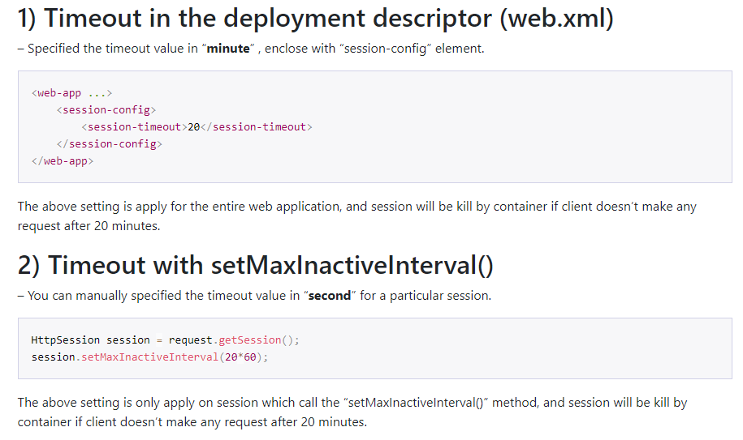

Slide 25
Session tracking
To associate a session with a user, web container can use several method, all of which involve passing an identifier between the client and the server. The identifier can be maintained on the client as a cookie, or the web component can include the identifier in every URL that is returned to the client.
Notes:
If your application uses session objects, you must ensure that session tracking is enabled by having the application rewrite URLs whenever the client turns off cookies. You do this by calling the response’s encodeURL(URL) method on all URLs returned by a servlet. This method includes the session ID in the URL only if cookies are disabled; otherwise, the method returns the URL unchanged.

Slide 26
Finalizing a servlet
The web container may determine that a servlet should be removed from service (For example, when a container wants to reclaim memory resources or when it í being shutdown). In such a case, the container calls the destroy method of the Servlet interface. In this method, you release any resources the servlet is using and save any persistent state. The destroy method releases the database object created in the init method.
A servlet’s service methods should all be complete when a servlet is removed. The server tries to ensure this by calling the destroy method only after all service requests have returned or after a server-specific grace period, whichever comes first. If your servlet has operations that may run longer than the server’s grace period, the operations could still be running when destroy is called. You must make sure that any threads still handling client requests complete.
The remainder of this section explains how to do the following
Keep track of how any threads are currently running the service method
Provide a clean shutdown by having the destroy method notify long-running threads of the shutdown and wait for them to complete
Have the long-running methods poll periodically to check for shutdown and, if necessary, stop working, clean up, and return

Slide 27
Tracking service requests
To track service requests, include in your servlet class a field that counts the number of service methods that are running. The field should have synchronized access methods to increment, decrement, and return its value

Slide 28
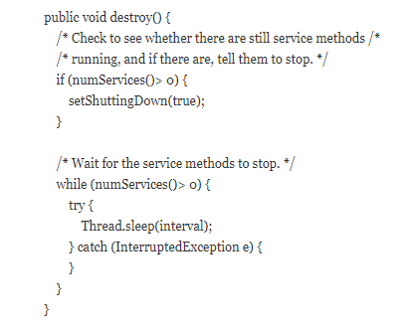
Notifying methods to shutdown
To ensure a clean shutdown, you destroy method should not release any shared resources until all the service requests have completed. One part of doing this is check the service counter. Another part is to notify long-running methods that it is time to shutdown. For this notification, another field is required. The field should have the usual access method.

Slide 29
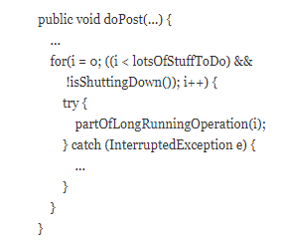
Creating polite long-running methods
The final step in providing a clean shutdown is to make any long-running methods behave politely. Methods that might run for a long time should check the value of the field that notifies them of shutdowns and should interrupt their network, if necessary

Slide 30
Uploading files with java servlet technology
/** * fileSizeThreshold: The file size in bytes after which the file will be temporarily stored on disk. The default size is 0 bytes. * * MaxFileSize: The maximum size allowed for uploaded files, in bytes. If the size of any uploaded file is greater * than this size, the web container will throw an exception (IllegalStateException). The default size is unlimited. * * location: An absolute path to a directory on the file system. The location attribute does not support a path * relative to the application context. This location is used to store files temporarily while the parts are processed * or when the size of the file exceeds the specified fileSizeThreshold setting. The default location is "". * * maxRequestSize: The maximum size allowed for a multipart/form-data request, in bytes. The web container will throw * an exception if the overall size of all uploaded files exceeds this threshold. The default size is unlimited. * * Instead of using the @MultipartConfig annotation to hard-code these attributes in your file upload servlet, * you could add the following as a child element of the servlet configuration element in the web.xml file: * * Ex: * <multipart-config> * <location>/tmp</location> * <max-file-size>20848820</max-file-size> * <max-request-size>418018841</max-request-size> * <file-size-threshold>1048576</file-size-threshold> * </multipart-config> * * The javax.servlet.http.Part interface is a simple one, providing methods that allow introspection of each Part. * The methods do the following: * * - Image Retrieve the name, size, and content-type of the Part * - Query the headers submitted with a Part * - Delete Part * - Write a Part out to disk * * For example, the Part interface provides the write(String filename) method to write the file with the specified name. * The file can then be saved in the directory that is specified with the location attribute of the @MultipartConfig * annotation or, in the case of the fileupload example, in the location specified by the Destination field in the form. */
Notes:
A new annotation, javax.servlet.annotation.MultipartConfig, is used to indicate that the servlet on which it is declared expects requests to be made using the multipart/form-data MIME type. Servlets that are annotated with @MultipartConfig can retrieve the Part components of a given multipart/form-data request by calling the request.getPart(String name) or request.getParts() method.

Slide 31
Asynchronous processing
There are two common scenarios in which a thread associated with a request can be sitting idle.
The thread needs to wait for a resource o become available or process data before building the response. For example, an application may need to query a database or access data from a remote web service before generating the response.
The thread needs to wait for an event before generating the response. For example, an application may have to wait for a JMS message, new information from another client, or new data available in a queue before generating the response.
Notes:
These scenarios represent blocking operations that limit the scalability of web applications. Asynchronous processing refers to assigning these blocking operations to a new thread and retuning the thread associated with the request immediately to the container

Slide 32
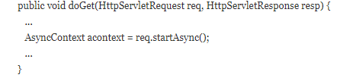
Asynchronous Processing in Servlets
Java EE provides asynchronous processing support for servlets and filters. If a servlet or a filter reaches a potentially blocking operation when processing a request, it can assign the operation to an asynchronous execution context and return the thread associated with the request immediately to the container without generating a response. The blocking operation completes in the asynchronous execution context in a different thread, which can generate a response or dispatch the request to another servlet.
The javax.servlet.AsyncContext class provides the functionality that you need to perform asynchronous processing inside service methods. To obtain an instance of AsyncContext, call the startAsync() method on the request object of your service method;
Notes:
To enable asynchronous processing on a servlet, set the parameter asyncSupported to true on the @WebServlet annotation as follows:

Slide 33
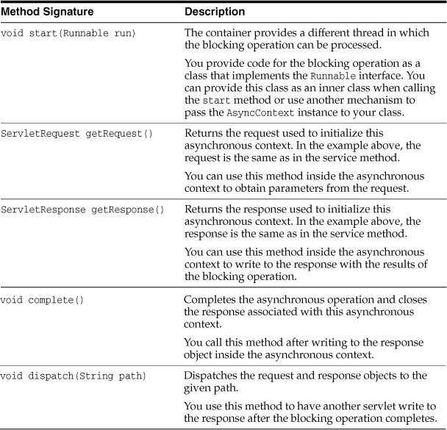
Cont
Basic functionality provided by the AsyncContext class.

Slide 34
Waiting for a resource
1. A servlet receives a parameter from a GET request.
2. The servlet uses a resource, such as a database or a web service, to retrieve information based on the value of the parameter. The resource can be slow at times, so this may be a blocking operation.
3. The servlet generates a response using the result from the resource.

Slide 35
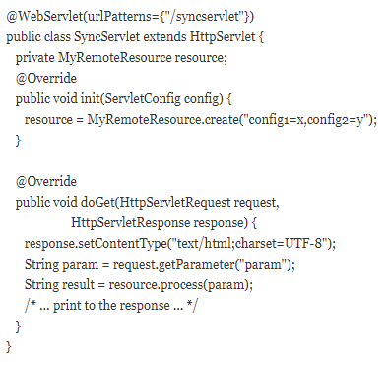
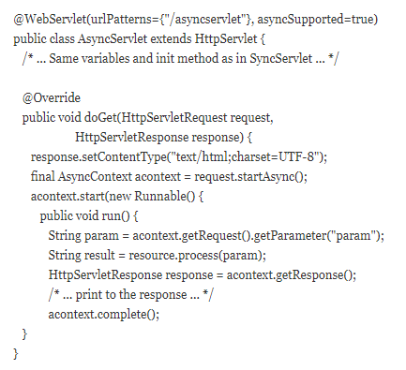
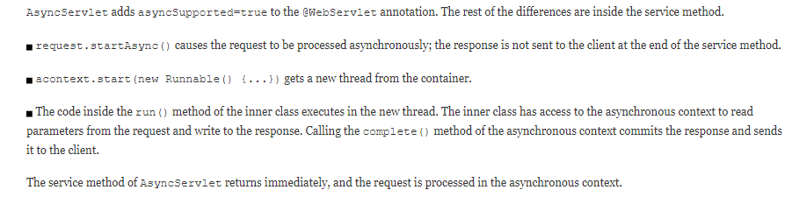

Slide 36
Nonblocking i/o
Even if you use asynchronous processing for all the application-specific blocking operations inside your service methods, threads associated with client requests can be momentarily sitting idle because of input/output considerations.
For example, if a client is submitting a large HTTP POST request over a slow network connection, the server can read the request faster than the client can provide it. Using traditional I/O, the container thread associated with this request would be sometimes sitting idle waiting for the rest of the request.
Java EE provides nonblocking I/O support for servlets and filters when processing requests in asynchronous mode. The following steps summarize how to use nonblocking I/O to process requests and write responses inside service methods.
1. Put the request in asynchronous mode as described in Section 17.12, “Asynchronous Processing.”
2. Obtain an input stream and/or an output stream from the request and response objects in the service method.
3. Assign a read listener to the input stream and/or a write listener to the output stream.
4. Process the request and the response inside the listener’s callback methods.

Slide 37
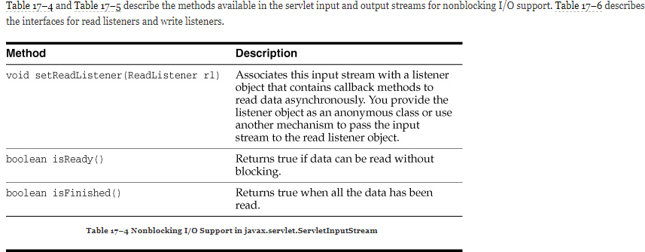
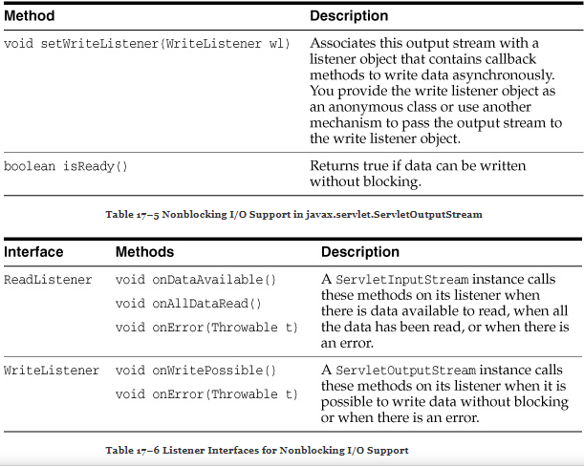

Slide 38
Example
@WebServlet(urlPatterns={"/asyncioservlet"}, asyncSupported=true) public class AsyncIOServlet extends HttpServlet { @Override public void doPost(HttpServletRequest request, HttpServletResponse response) throws IOException { final AsyncContext acontext = request.startAsync(); final ServletInputStream input = request.getInputStream(); input.setReadListener(new ReadListener() { byte buffer[] = new byte[4*1024]; StringBuilder sbuilder = new StringBuilder(); @Override public void onDataAvailable() { try { do { int length = input.read(buffer); sbuilder.append(new String(buffer, 0, length)); } while(input.isReady()); } catch (IOException ex) { ... } } @Override public void onAllDataRead() { try { acontext.getResponse().getWriter() .write("...the response..."); } catch (IOException ex) { ... } acontext.complete(); } @Override public void onError(Throwable t) { ... } }); } }

Slide 39
Protocol upgrade processing
In HTTP/1.1, clients can request to switch to a different protocol on the current connection by using the Upgrade header field. If server accept the request to switch to the protocol indicated by the client, it generates an HTTP response with status 101 (switching protocols). After this exchange, the client and the server communicate using the new protocol

Slide 40
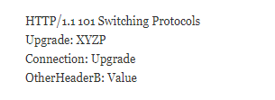
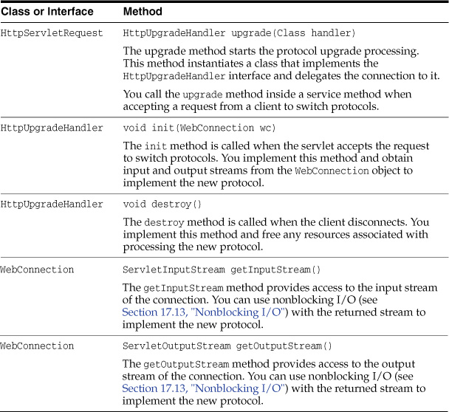
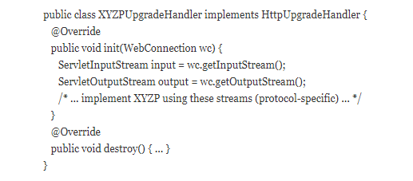
@WebServlet(urlPatterns={"/xyzpresource"}) public class XYZPUpgradeServlet extends HttpServlet { @Override public void doGet(HttpServletRequest request, HttpServletResponse response) { if ("XYZP".equals(request.getHeader("Upgrade"))) { /* Accept upgrade request */ response.setStatus(101); response.setHeader("Upgrade", "XYZP"); response.setHeader("Connection", "Upgrade"); response.setHeader("OtherHeaderB", "Value"); /* Delegate the connection to the upgrade handler */ XYZPUpgradeHandler = request.upgrade(XYZPUpgradeHandler.class); /* (the service method returns immedately) */ } else { /* ... write error response ... */ } } }

